Slide 1

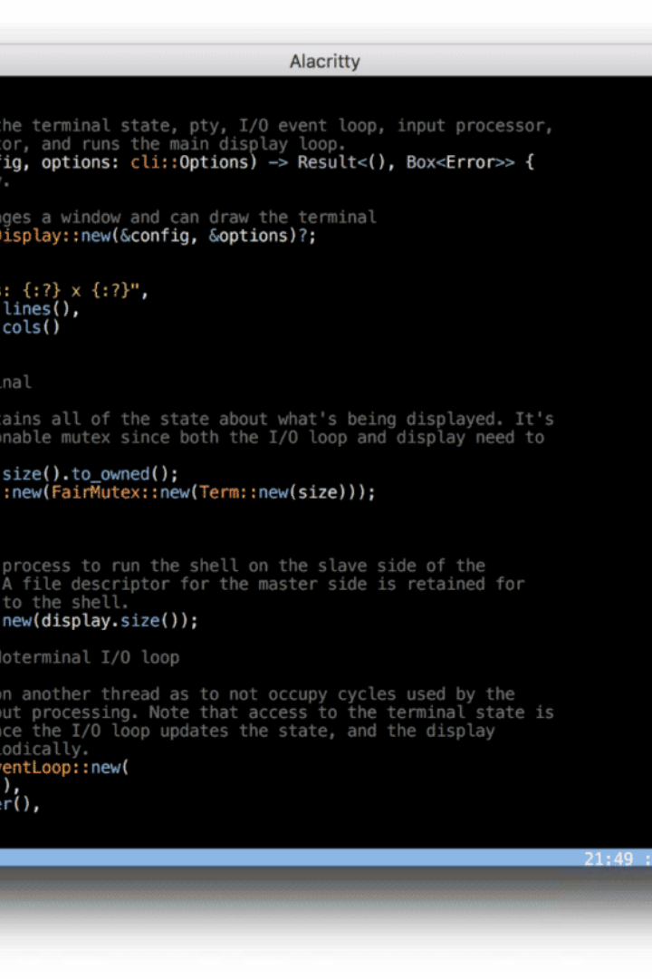

System Calls in Linux
Welcome to the world of System Calls! Learn about the fundamental mechanisms that allow applications to interact with the Linux operating system.

Slide 2

Introduction
System calls play a crucial role in Linux by providing a bridge between user-level processes and the kernel. Discover why system calls are essential for Linux's functionality.

Slide 3

System Call Basics
Explore the foundations of system calls, including their definition, how they work, and the different types that exist within the Linux environment.

Slide 4

System Call Examples
Delve into commonly used system calls and witness how they are coded. Gain insight into the practical applications of system calls in various scenarios.

Slide 5

System Call Interface
Learn how to make system calls in Linux, including understanding system call numbers and parameters. Uncover techniques for error handling in system calls.

Slide 6

System Call Implementation
Discover the inner workings of system call implementation, such as the difference between kernel mode and user mode and the flow of system calls in the Linux kernel. Gain insight into how system calls are handled within the kernel.

Slide 7
Conclusion
Recap the key points of system calls in Linux, understanding their importance and envisioning future developments in this critical aspect of the operating system.

